Slide 1
Stack Exchange Dataset Analysis
GROUP:
ABHISHEK NANDGAONKAR
KRUNAL NISAR
MANALI CHHEDA

Slide 2


Slide 3
Stack Exchange Datasets used
Ask Ubuntu
Stack Overflow
Initial operations performed on Ask Ubuntu and tested on Stack Overflow for testing scalability
Data for six years processed
Earliest Post: 2009-01-08
Latest Post: 2016-03-06

Slide 4
Technologies and Tools Used
MapReduce
HBase
Pig
Hive
Apache Mahout
Azure ML Clustering
Power-BI
Amazon EC2
Java

Slide 5
Input
Input in XML format available off archive.org/details/stackexchange
Input split into 8 files:
Badges Comments
PostHistory PostLinks
Posts Tags
Users Votes

Slide 6
Data Load Process
Step One: Input data processing
Step Two: Create HBase tables
Step Three: Pig script to filter, format and load data to HBase
Step Four: Hive query to extract data from Hbase.

Slide 7
PIG HBase Integration
raw_data = LOAD 'posts.csv' USING PigStorage(',') AS (id:long,postTypeId:long,acceptedAnswerId:long,creationDate:chararray,score:long,viewCount:long,ownerUserId:long,lastEditorUserId:long,lastEditDate:chararray,lastActivityDate:chararray,title:chararray,tags:chararray,answerCount:long,commentCount:long,favoriteCount:long,parentId:chararray,communityOwnedDate:chararray,closedDate:chararray,ownerDisplayName:chararray,lastEditorDisplayName:chararray);
filter_data_answer = FILTER raw_data BY id is not null;
filter_data = FILTER filter_data_answer BY postTypeId == 2;
postTypeId = FOREACH filter_data GENERATE ($1 IS NOT NULL ? $1 : -1);
acceptedAnswerId = FOREACH filter_data GENERATE ($2 IS NOT NULL ? $2 : -1);
STORE filter_data INTO 'hbase://posts_answer' USING org.apache.pig.backend.hadoop.hbase.HBaseStorage('posts_data:postTypeId posts_data:acceptedAnswerId posts_data:creationDatepost_tags_eachdata posts_data:score posts_data:viewCount posts_data:ownerUserId posts_data:lastEditorUserId posts_data:lastEditDate posts_data:lastActivityDate posts_data:title posts_data:tags posts_data:answerCount posts_data:commentCount posts_data:favoriteCount posts_data:parentId posts_data:communityOwnedDate posts_data:closedDate posts_data:ownerDisplayName posts_data:lastEditorDisplayName');

Slide 8
HIVE HBase Integration
CREATE EXTERNAL TABLE posts_answer
(id BIGINT,postTypeId BIGINT,acceptedAnswerId BIGINT,creationDate STRING,score BIGINT,viewCount BIGINT,ownerUserId BIGINT,lastEditorUserId BIGINT,lastEditDate STRING,lastActivityDate STRING,title STRING,tags STRING,answerCount BIGINT,commentCount BIGINT,favoriteCount BIGINT,parentId BIGINT,communityOwnedDate STRING,closedDate STRING,ownerDisplayName STRING,lastEditorDisplayName STRING)
STORED BY 'org.apache.hadoop.hive.hbase.HBaseStorageHandler' WITH SERDEPROPERTIES ('hbase.columns.mapping' = ':key,posts_data:postTypeId,posts_data:acceptedAnswerId, posts_data:creationDatepost_tags_eachdata,posts_data:score,posts_data:viewCount,posts_data:ownerUserId,posts_data:lastEditorUserId,posts_data:lastEditDate,posts_data:lastActivityDate,posts_data:title,posts_data:tags,posts_data:answerCount,posts_data:commentCount,posts_data:favoriteCount,posts_data:parentId,posts_data:communityOwnedDate,posts_data:closedDate,posts_data:ownerDisplayName,posts_data:lastEditorDisplayName') TBLPROPERTIES ('hbase.table.name' = 'posts_answer');

Slide 9
Analysis - Users
People who answer their own questions
Profile with maximum views and profile with maximum reputation
Users that have been awarded badges vs Users that have not been awarded badges
User registrations by year
Inactive accounts vs Longest active accounts
Popular Users
Number of accepted answers vs Age of users
Notes:
id bigint from deserializer
reputation bigint from deserializer
creationdate string from deserializer
displayname string from deserializer
lastaccessdate string from deserializer
websiteurl string from deserializer
views bigint from deserializer
upvotes bigint from deserializer
downvotes bigint from deserializer
accountid bigint from deserializer
age bigint from deserializer
profileimageurl string from deserializer

Slide 10
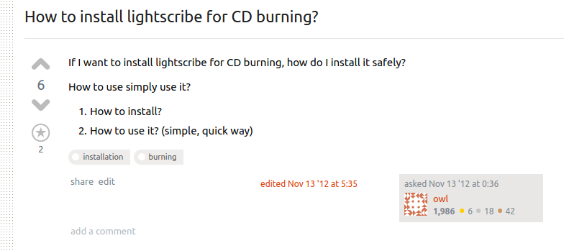
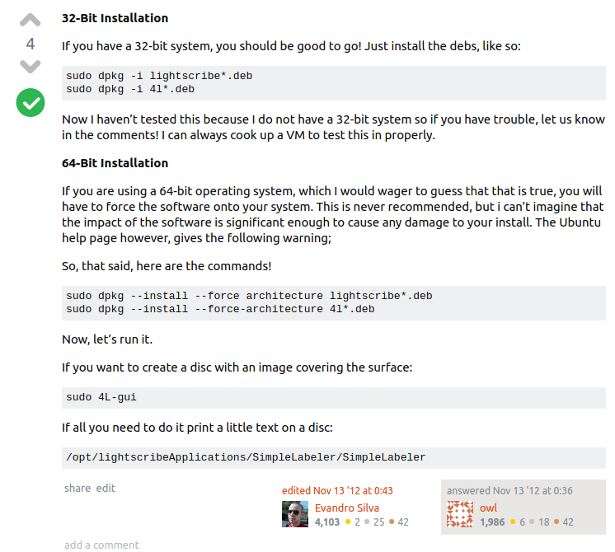
Users who answer their own questions
63 other users like Mr. Owl do this

Slide 11
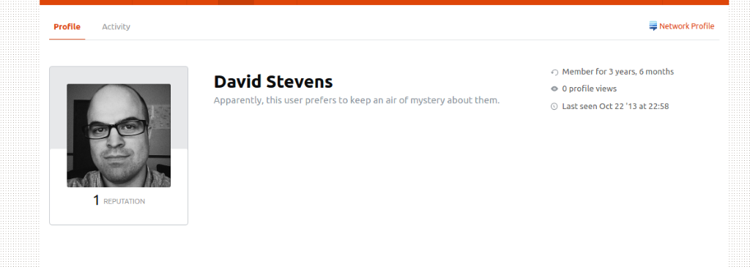
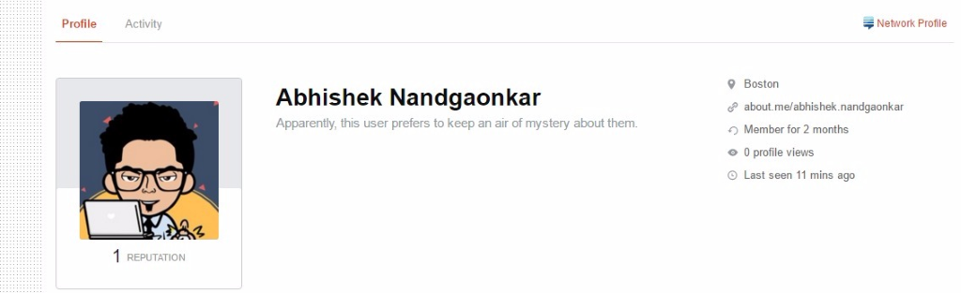
Users with no badges awarded: 128506
Users that joined the website in the last six months: 195791

Slide 12
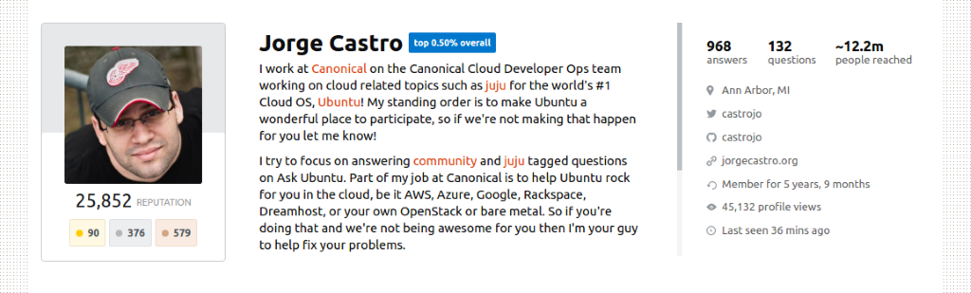
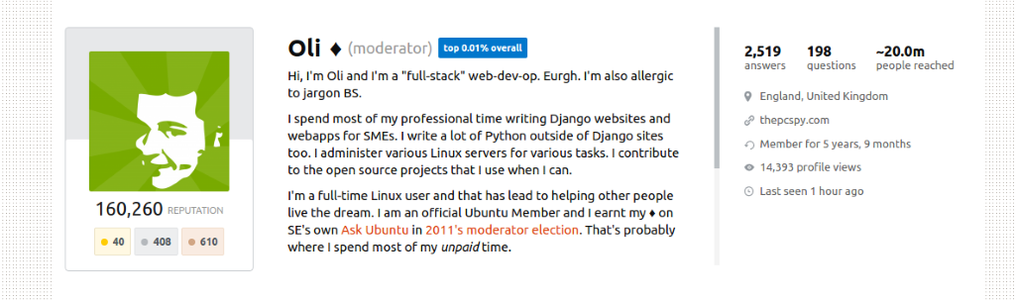
User with maximum views
User with maximum reputation

Slide 13
Analysis - Posts
Top 10 trending Questions that are viewed and scored highly by users.
Number of questions posted every year
Count of questions that have answers vs Count of questions that do not have answers
Questions with at least five answers but no accepted answer
Number of Questions that are not closed
The Questions that are dead and have no activity past 2 years.
Question Recommendation to users by clustering
The top posted Questions in each category.
Most popular posts
Average Time taken to close questions (in days)
Notes:
Posts divided into Posts questions and posts answers
id bigint from deserializer
posttypeid bigint from deserializer
acceptedanswerid bigint from deserializer
creationdate string from deserializer
score bigint from deserializer
viewcount bigint from deserializer
owneruserid bigint from deserializer
title string from deserializer
tags string from deserializer
answercount bigint from deserializer
commentcount bigint from deserializer
favoritecount bigint from deserializer
parentid bigint from deserializer
communityowneddate string from deserializer
closeddate string from deserializer
ownerdisplayname string from deserializer
lasteditordisplayname string from deserializer

Slide 14
Analysis - Tags
Category most questions belong to
Overused tags vs Underused tags
Popularity of tags by year
Tags that need to have a wiki page
New tags introduced every year
Notes:
id bigint from deserializer
tagname string from deserializer
count bigint from deserializer
excerptpostid bigint from deserializer
wikipostid bigint from deserializer

Slide 15
Analysis - Votes
AcceptedByOriginator UpMod
DownMod Offensive
Favorite Close
Reopen BountyStart
BountyClose Deletion
Undeletion Spam
ModeratorReview ApproveEditSuggestion

Slide 16
Analysis - Votes
Count of votes by vote type
Number of spam posts
List of users who post spam

Slide 17
PageRank
Every post has related posts and linked posts associated to it that act as outlinks.
The popular pages are present in more outlinks
To indicate all the posts that should be a part of outinks but are not, we use pagerank to find which are eligible to be an outlink but is not
Damping factor set to 0.25
We then use Mahout Recommendation, Similarity co-occurrence and plain simple wordcount to accomplish it.

Slide 18
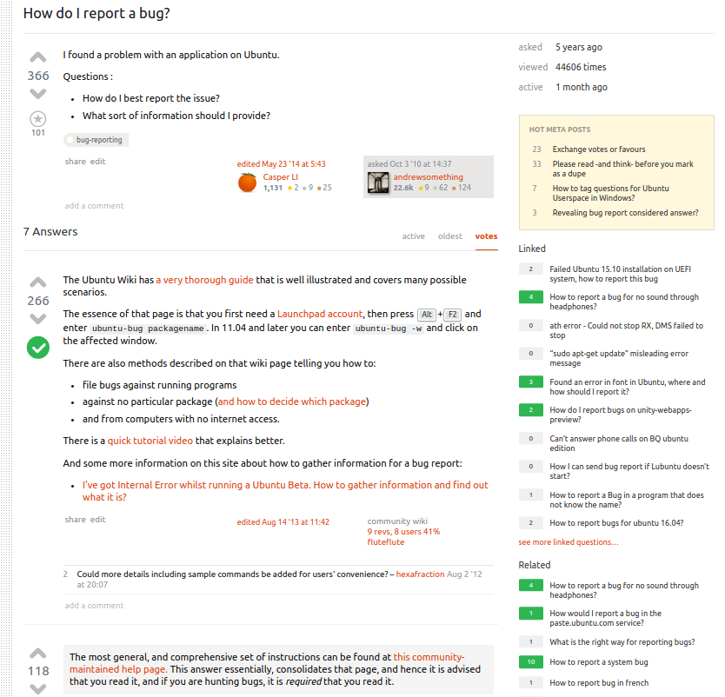
Pages with higher pagerank value

Slide 19
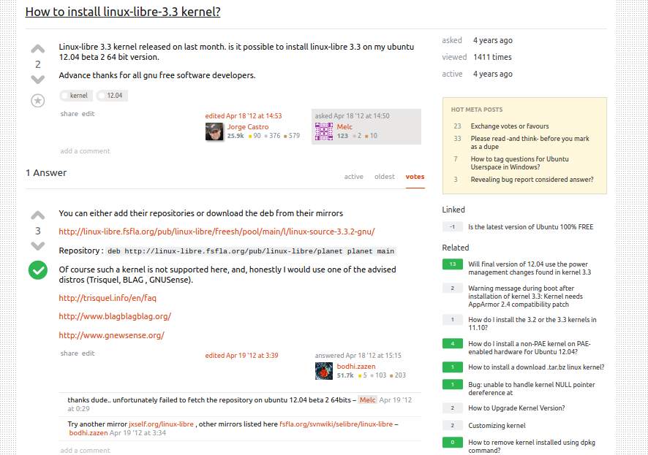
Pages with lower pagerank value

Slide 20
Recommendation algorithms
User Based Mahout Recommendation:
Recommending user with the categories on which they can answer to questions.
For this we gave input as UserId, CategoryId and Count of each category used by user to Mahout User Recommender.
We used PearsonCorrelationSimilarity and ThresholdUserNeighborhood as neighborhood.
We then used Mahout UserBasedRecommendation to provide 5 recommendations to user of the categories for which he can answer.

Slide 21
Result of User Based Recommendation
User based Recommendation
User id: 33833
Recommendation:
4350 qml value:4.1173587
4649 wmctrl value:3.8936887
2491 juju value:3.3749545
4556 ubuntu-sdk value:3.571057
5956 backintime value:3.505782

Slide 22
User id: 449
Recommendation:
7415 realtek-wireless value:13.256689
4350 qml value:6.2924504
4556 ubuntu-sdk value:4.9414606
2491 juju value:4.3232136
4649 wmctrl value:4.244056

Slide 23
Clustering
Cluster users which have same domain knowledge.

Slide 24
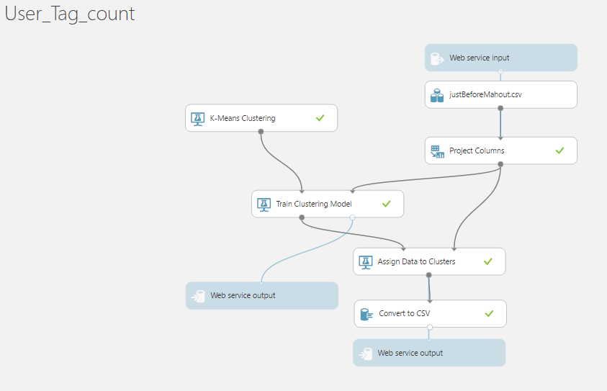
Clustering using AzureML

Slide 25
